Slide 1
4DB001 - Database
Week-04, Lecture-04

Slide 2
Introduction to Unified Modeling Language(UML)
Anmol Adhikari

Slide 3

What’s in it for you?
Basic concept of UML diagram
Use-case modeling
Generalization
Usecase diagram
Actors, Goals
System Boundary and Subsystems

Slide 4
Scenario - Deriving Use Cases from System Requirements
REQ1: Keep door locked and auto-lock
REQ2: Lock when “LOCK” pressed
REQ3: Unlock when valid key provided
REQ4: Allow mistakes but prevent dictionary attacks
REQ5: Maintain a history log
REQ6: Adding/removing users at runtime
REQ7: Configuring the device activation preferences
REQ8: Inspecting the access history
REQ9: Filing inquiries
Initiator | Initiator’s Goal | Participants | Use Case Name
Tenant | Unlock and enter home. | Lock, Household Devices, Database | Unlock (UC‑1)
Tenant | Lock the door. | Lock, Household Devices, Database | Lock (UC‑2)
Landlord | Create a new user account and allow access to home. | Tenant, Database | AddUser (UC‑3)
Landlord | Retire an existing user account and disable access. | Database | RetireUser (UC‑4)
Tenant | Review the history of home accesses. | Database | ViewHistory (UC‑5)
Tenant | Configure the operational preferences for household devices. | Database | SetDevicePrefs (UC‑6)
Visitor | Visit a resident’s home. | Lock, Database | VisitHome (UC‑7)

Slide 5
1. Unified Modeling Language
The Unified Modeling Language™ (UML) was developed jointly by Grady Booch, Ivar Jacobson, and Jim Rumbaugh with contributions from other leading methodologists, software vendors, and many users. The UML provides the application modeling language for:
Process modeling/ Requirement Analysis with Use-cases.
Static Design with Class and object modeling.
Dynamic Design with sequence, collaboration and activity diagrams.
Realtime Systems design models
Distribution and deployment modeling.

Slide 6
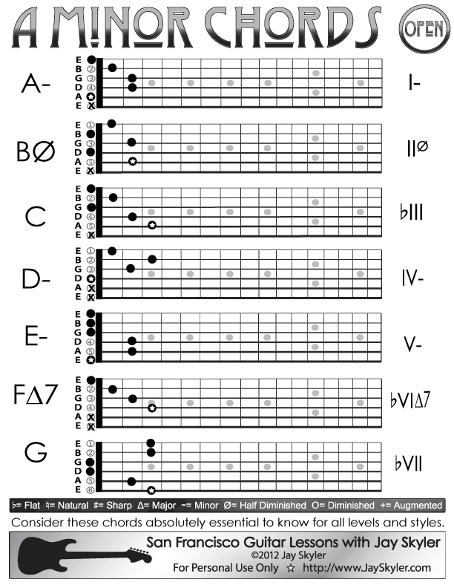
2. Why UML?
Other industries have languages and notations, which are understood by every member of that particular field.
For example: Guitarists team can understand these notations and can compose music.
For Software engineering, such notations lack but in 1995 UML was introduced in an aim to give a common language to all software industries people.

Slide 7
3. UML – To rescue
UML attempts to provide a common language so that all project stakeholders can benefit from at least one UML diagram.
UML diagrams | Use | Stakeholders benefited
1. UseCase diagram | Valuable aid during analysis and developing Use Cases helps us to understand requirements. | Both developers (analysts, designers, coders, tests) and the customer
2. Class Diagram | Essential part of OOD method and can be used in both Analysis and design | Developers(analysts, designers, coders, tests) and the customer

Slide 8
3. UML diagrams
Diagrams in UML can be broadly classified as:
Structural Diagrams – Capture static aspects or structure of a system. Structural Diagrams include: Component Diagrams, Object Diagrams, Class Diagrams and Deployment Diagrams.
Behavior Diagrams – Capture dynamic aspects or behavior of the system. Behavior diagrams include: Use Case Diagrams, State Diagrams, Activity Diagrams and Interaction Diagrams.

Slide 9
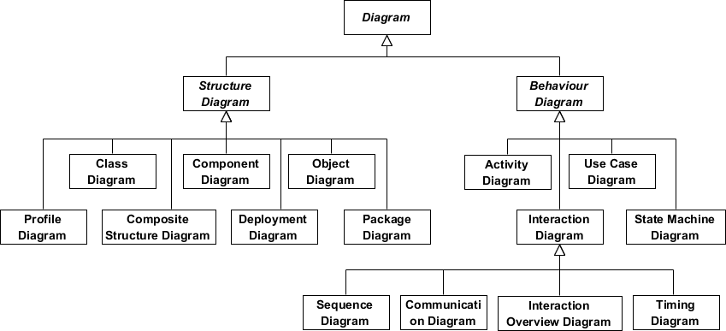
3. UML diagrams(cont..)

Slide 10
4. Use-Case Modeling
In use-case modeling, the system is looked upon as a black box whose boundaries are defined by its functionality to external stimuli.
The actual description of the use-case is usually given in plain text. A popular notation promoted by UML is the stick figure notation.
We will investigate the details of text representation later. Both visual and text representation are needed for a complete view.
A use-case model represents the use-case view of the system. A use-case view of a system may consist of many Use-case diagrams.
An use-case diagram shows (the system), the actors, the use-cases and the relationship among them.

Slide 11
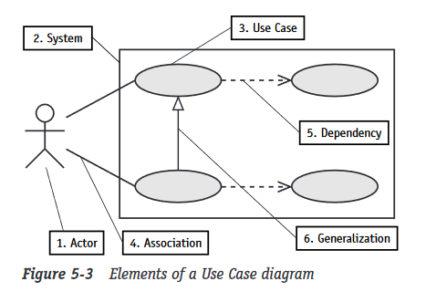
4.1. Components of Use-case Model
The components of a Use-case model are:
System Modeled
Actors
Use-cases
Association
Generalization
Dependency

Slide 12
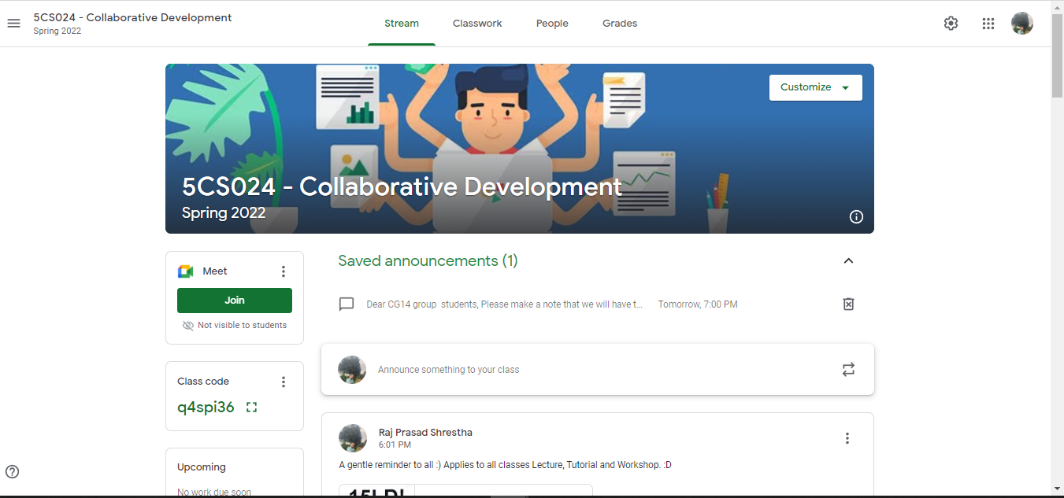

4.2. Example of Use-case diagram
Join Google meet
View Announcements
Post Announcement
Usecases = Software features
System Boundary

Slide 13
4.3. Actors
An actor is something or someone that interacts with the system.
Actor communicates with the system by sending and receiving messages.
An actor provides the stimulus to activate a Use-case.
Message sent by an actor may result in more messages to actors and to Use-cases.
Actors can be ranked: primary and secondary; passive and active.
Actor is a role not an individual instance.
Notation for an actor:

Slide 14
4.3.1. Finding Actors
The actors of a system can be identified by answering several questions:
Who will use the functionality of the system?
Who will maintain the system?
What devices does the system need to handle?
What other system does this system need to interact?
Who or what has interest in the results of this system?

Slide 15
4.3.2. Example on Actor
For example, if we were developing a banking system, and we have a Use Case called “withdraw money”, then we would identify that we require customers to be able to withdraw money, and hence a customer would become one of our actors.
Customer

Slide 16
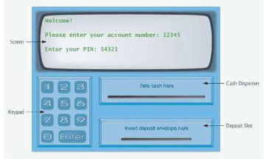
4.3.3. Example on Actor
Going further, actors can be more than just people.
An actor can be anything external to the system that initiates a Use Case, such as another computer system.
ATM system
Database system

Slide 17
4.4. Use-cases
A Use-case in UML is defined as a set of sequences of actions a system performs that yield an observable result of value to a particular actor.
Actions can involve communicating with number of actors as well as performing calculations and work inside the system.
A Use-case
is always initiated by an actor.
provides a value to an actor.
must always be connected to at least one actor.
must be a complete description.

Slide 18
4.4.1. Finding Use-cases
For each actor ask these questions:
Which functions does the actor require from the system?
What does the actor need to do?
Could the actor’s work be simplified or made efficient by new functions in the system?
What events are needed in the system?
What are the problems with the existing systems?
What are the inputs and outputs of the system?

Slide 19
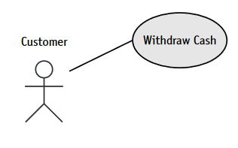
4.4.2. Example on Use-cases
For example, if we were developing a banking system, and we have a Use Case called “withdraw money” then we would identify that we require customers to be able to withdraw money, and hence a customer would become one of our actors. Again, the notation for an actor is simple
Association

Slide 20
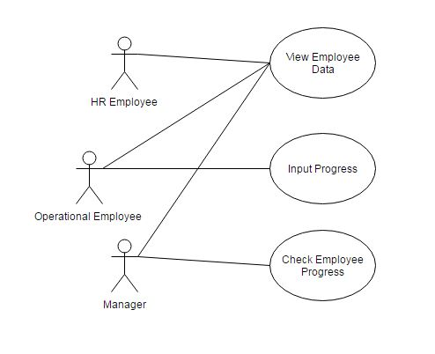
4.4.3. Example on Use-cases
Clearly, for most systems, a single actor can interact with many use cases, and a single use case can be initiated by many different actors. This leads to the full use case diagram, an example of which follows:

Slide 21
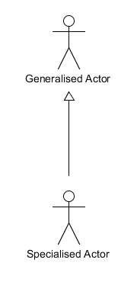
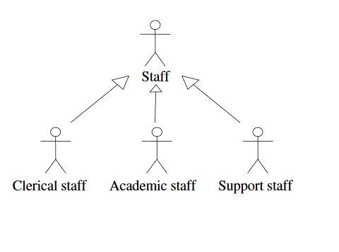
4.5. Actor Generalizations
Generalization(Inheritance) of an actor means that one actor can inherit the role of the other actor.
Rule:
Place Your Primary Use Cases In The Top-Left Corner Of The Diagram

Slide 22
4.6. Use-case Relationships - Association
A line connecting an actor to a Use Case represents an association
The association represents the fact that the actor communicates with the Use Case
Verb
Rule:
Name Use case name Begin with a verb

Slide 23
4.7. Include Dependeny relationships between Use-case
Sometimes one Use Case may need to ask for help from another Use Case.
For example, UseCases titled “Deposit Money” and “Withdraw Money” actually update a bank account.
“Deposit Money” and “Withdraw Money” usecases may delegate(appoint) the changes to an existing Use Case called “Update Account” so that changes are controlled through a single feature that guarantees that all changes are done correctly.

Slide 24
4.7. Include Dependeny relationships between Use-case(cont..)
When one Use Case delegates to another, the dependency is drawn as a dashed arrow from the “using” Use Case to the “used” Use Case and labeled with the <<include>> notation
Using Usecase
<<include>>
Used Usecase
This conveys that executing the “using” (or calling)Use Case will include or incorporate the functionality of the “used” Use Case.

Slide 25
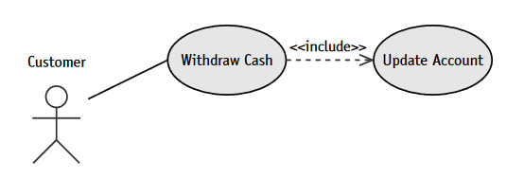
4.7.1. Include Dependency Example
Included Usecase
Including Usecase
Here “Withdraw Cash” usecase (Including usecase) calls or invokes the “Update account”(Included usecase)

Slide 26
4.8. Extend Dependeny relationships between Use-case
One Use Case might need help from another Use Case.
In contrast, the <<include>>dependency says that one UseCase will always call the other Use Case
Somewhere in the logic of the Use Case that needs the help is an extension point,a condition test that determines whether or not the calls should be made.
There is no such condition in an include dependency.

Slide 27
4.8. Extend Dependeny relationships between Use-case(cont..)
The <<include>> dependency arrow points from the main Use Case (the one currently executing) to the one that it needs help from.
Extending Usecase
<<extend>>
Extended Usecase
The <<extend>> dependency arrow points from the extension Use Case (the one providing the extra help) to the main Use Case that it is helping.

Slide 28
4.8.1. Extended Dependency Example
Make transaction
Seek help
<<extend>>
Here “Make transaction” usecase (Extending usecase) may calls or invokes the “Seek Help”(Extended usecase) only under certain conditions.

Slide 29
4.9. Some tips to make UML diagrams
Clear (spacing) and simple – depicts the actual flow of the system
Must follow the rules of each symbols ( usecase name must start with a verb, each symbol has its meaning please use carefully)
Don’t overuse include and extend usecase dependency relationship ( 4-5 are fine)
Place the support users or another external subsystems ( that makes the usecase operate) in the right side of system boundary. (Secondary users- Database,External services like payment processor/ mail processor/schedule processor etc)

Slide 30

Challenge Question
Explain the purpose of UML (Unified Modeling Language) in software development. Why is it widely used in the industry?
Define the concept of a use case in software engineering. How does it capture functional requirements in a system?
Differentiate between primary actors and secondary actors in a use case diagram. Provide an example scenario illustrating their roles.

Slide 31
In Workshop
Questions & Answers
Case study on use-case

Slide 32
At the end…….
Now you are qualified for understanding unified modeling language!
Questions?

